Slide 1
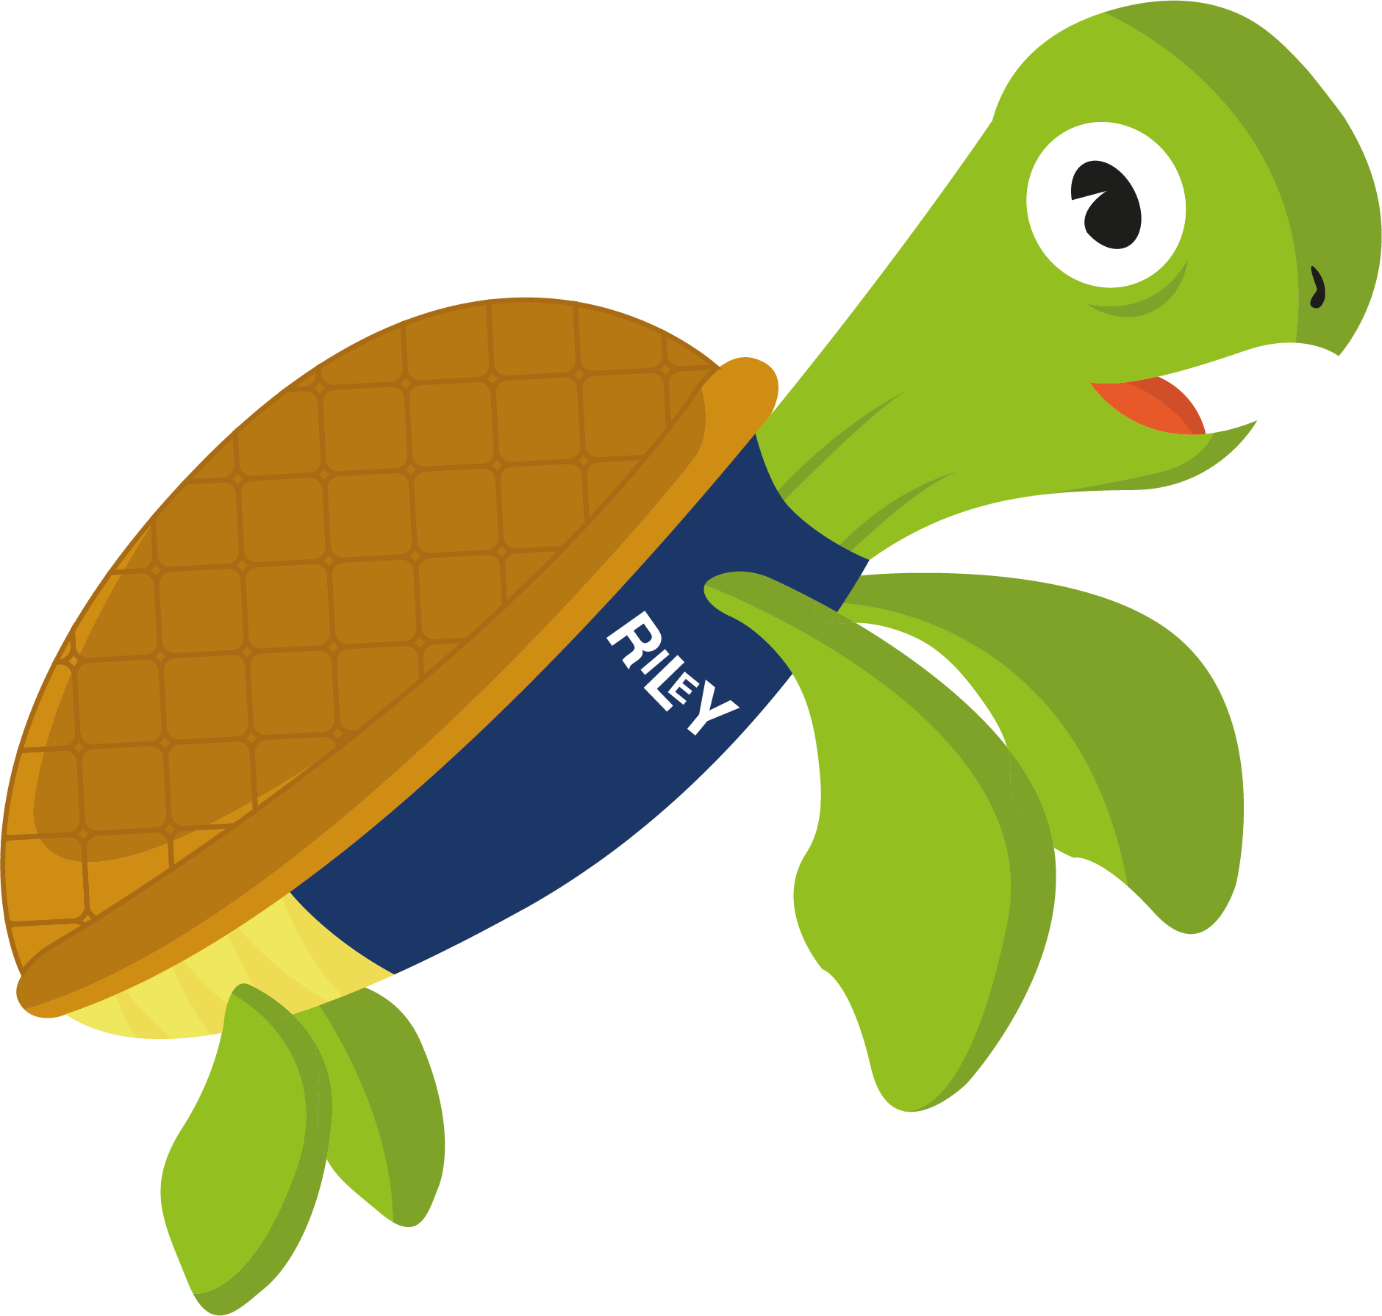

Slide 2
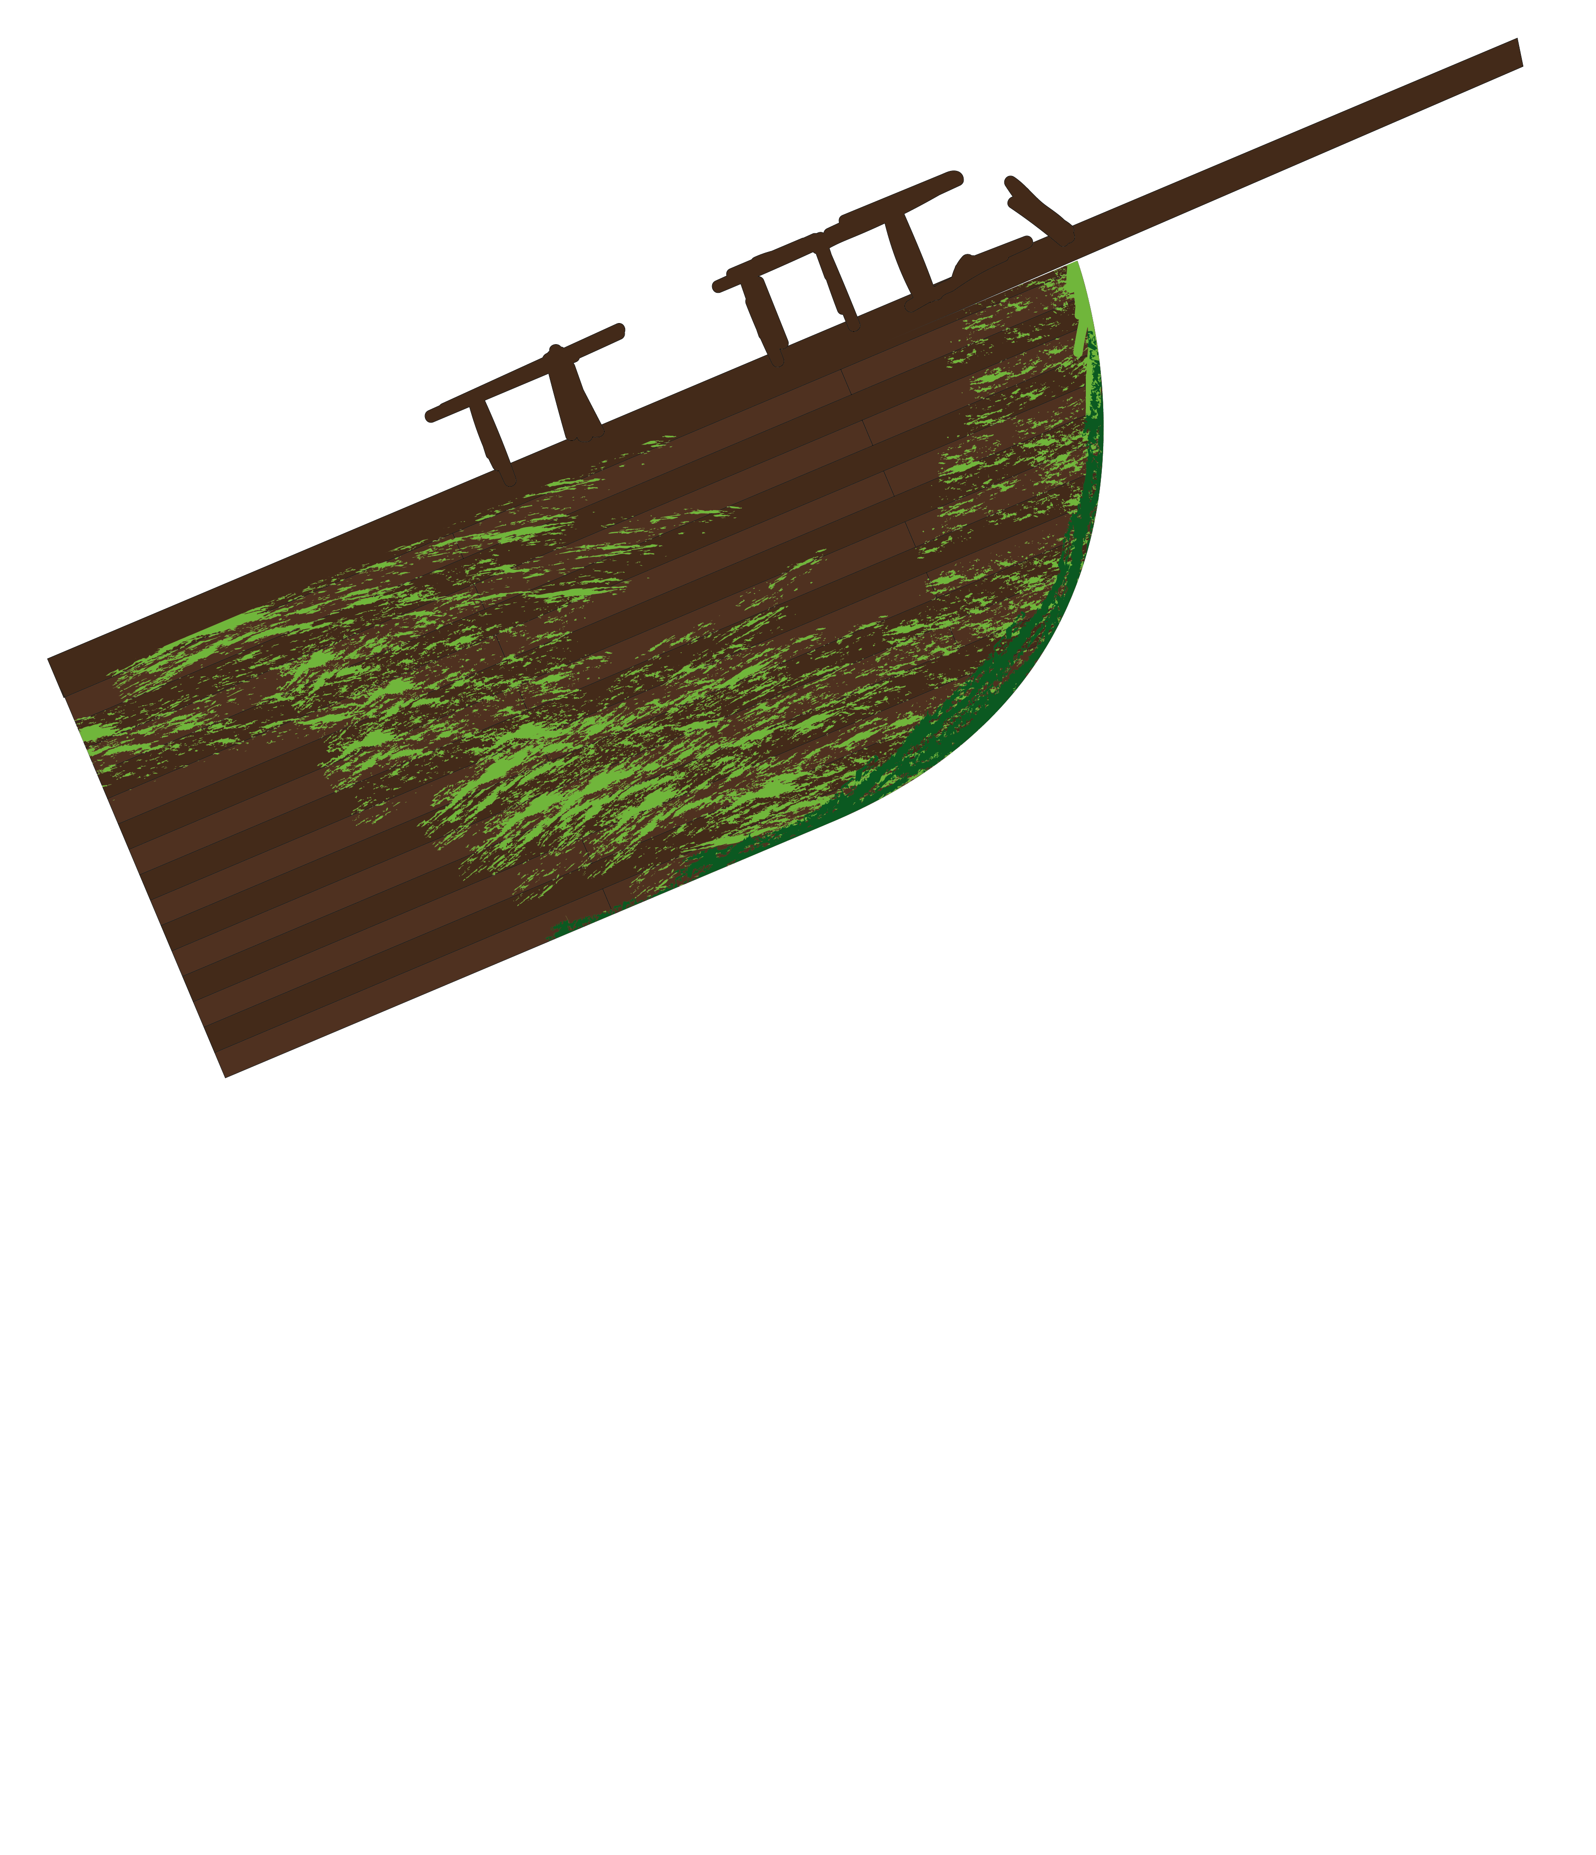


What is recycling?
Recycling is when products we no longer need are turned into new products

Slide 3


There are three rules for recycling, known as the three R’s

Slide 4
Reduce
This is to cut the amount of waste we throw away
For example, you can reduce waste sent to landfill by choosing what you throw away and what you recycle

Slide 5
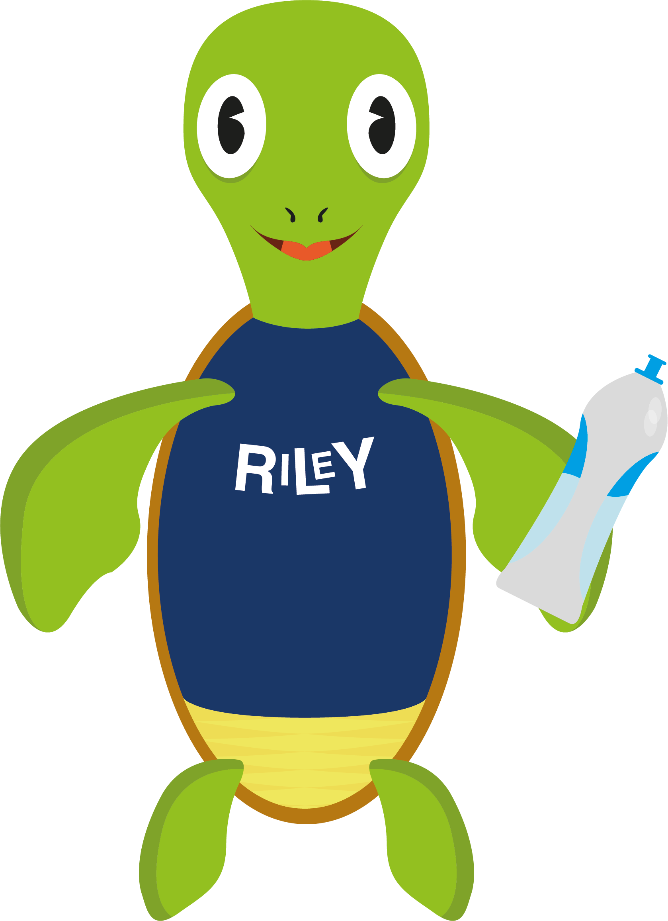
Reuse
To use less of something
For example, instead of bringing a new drinks bottle to school every day bring the same bottle and simply refill it

Slide 6
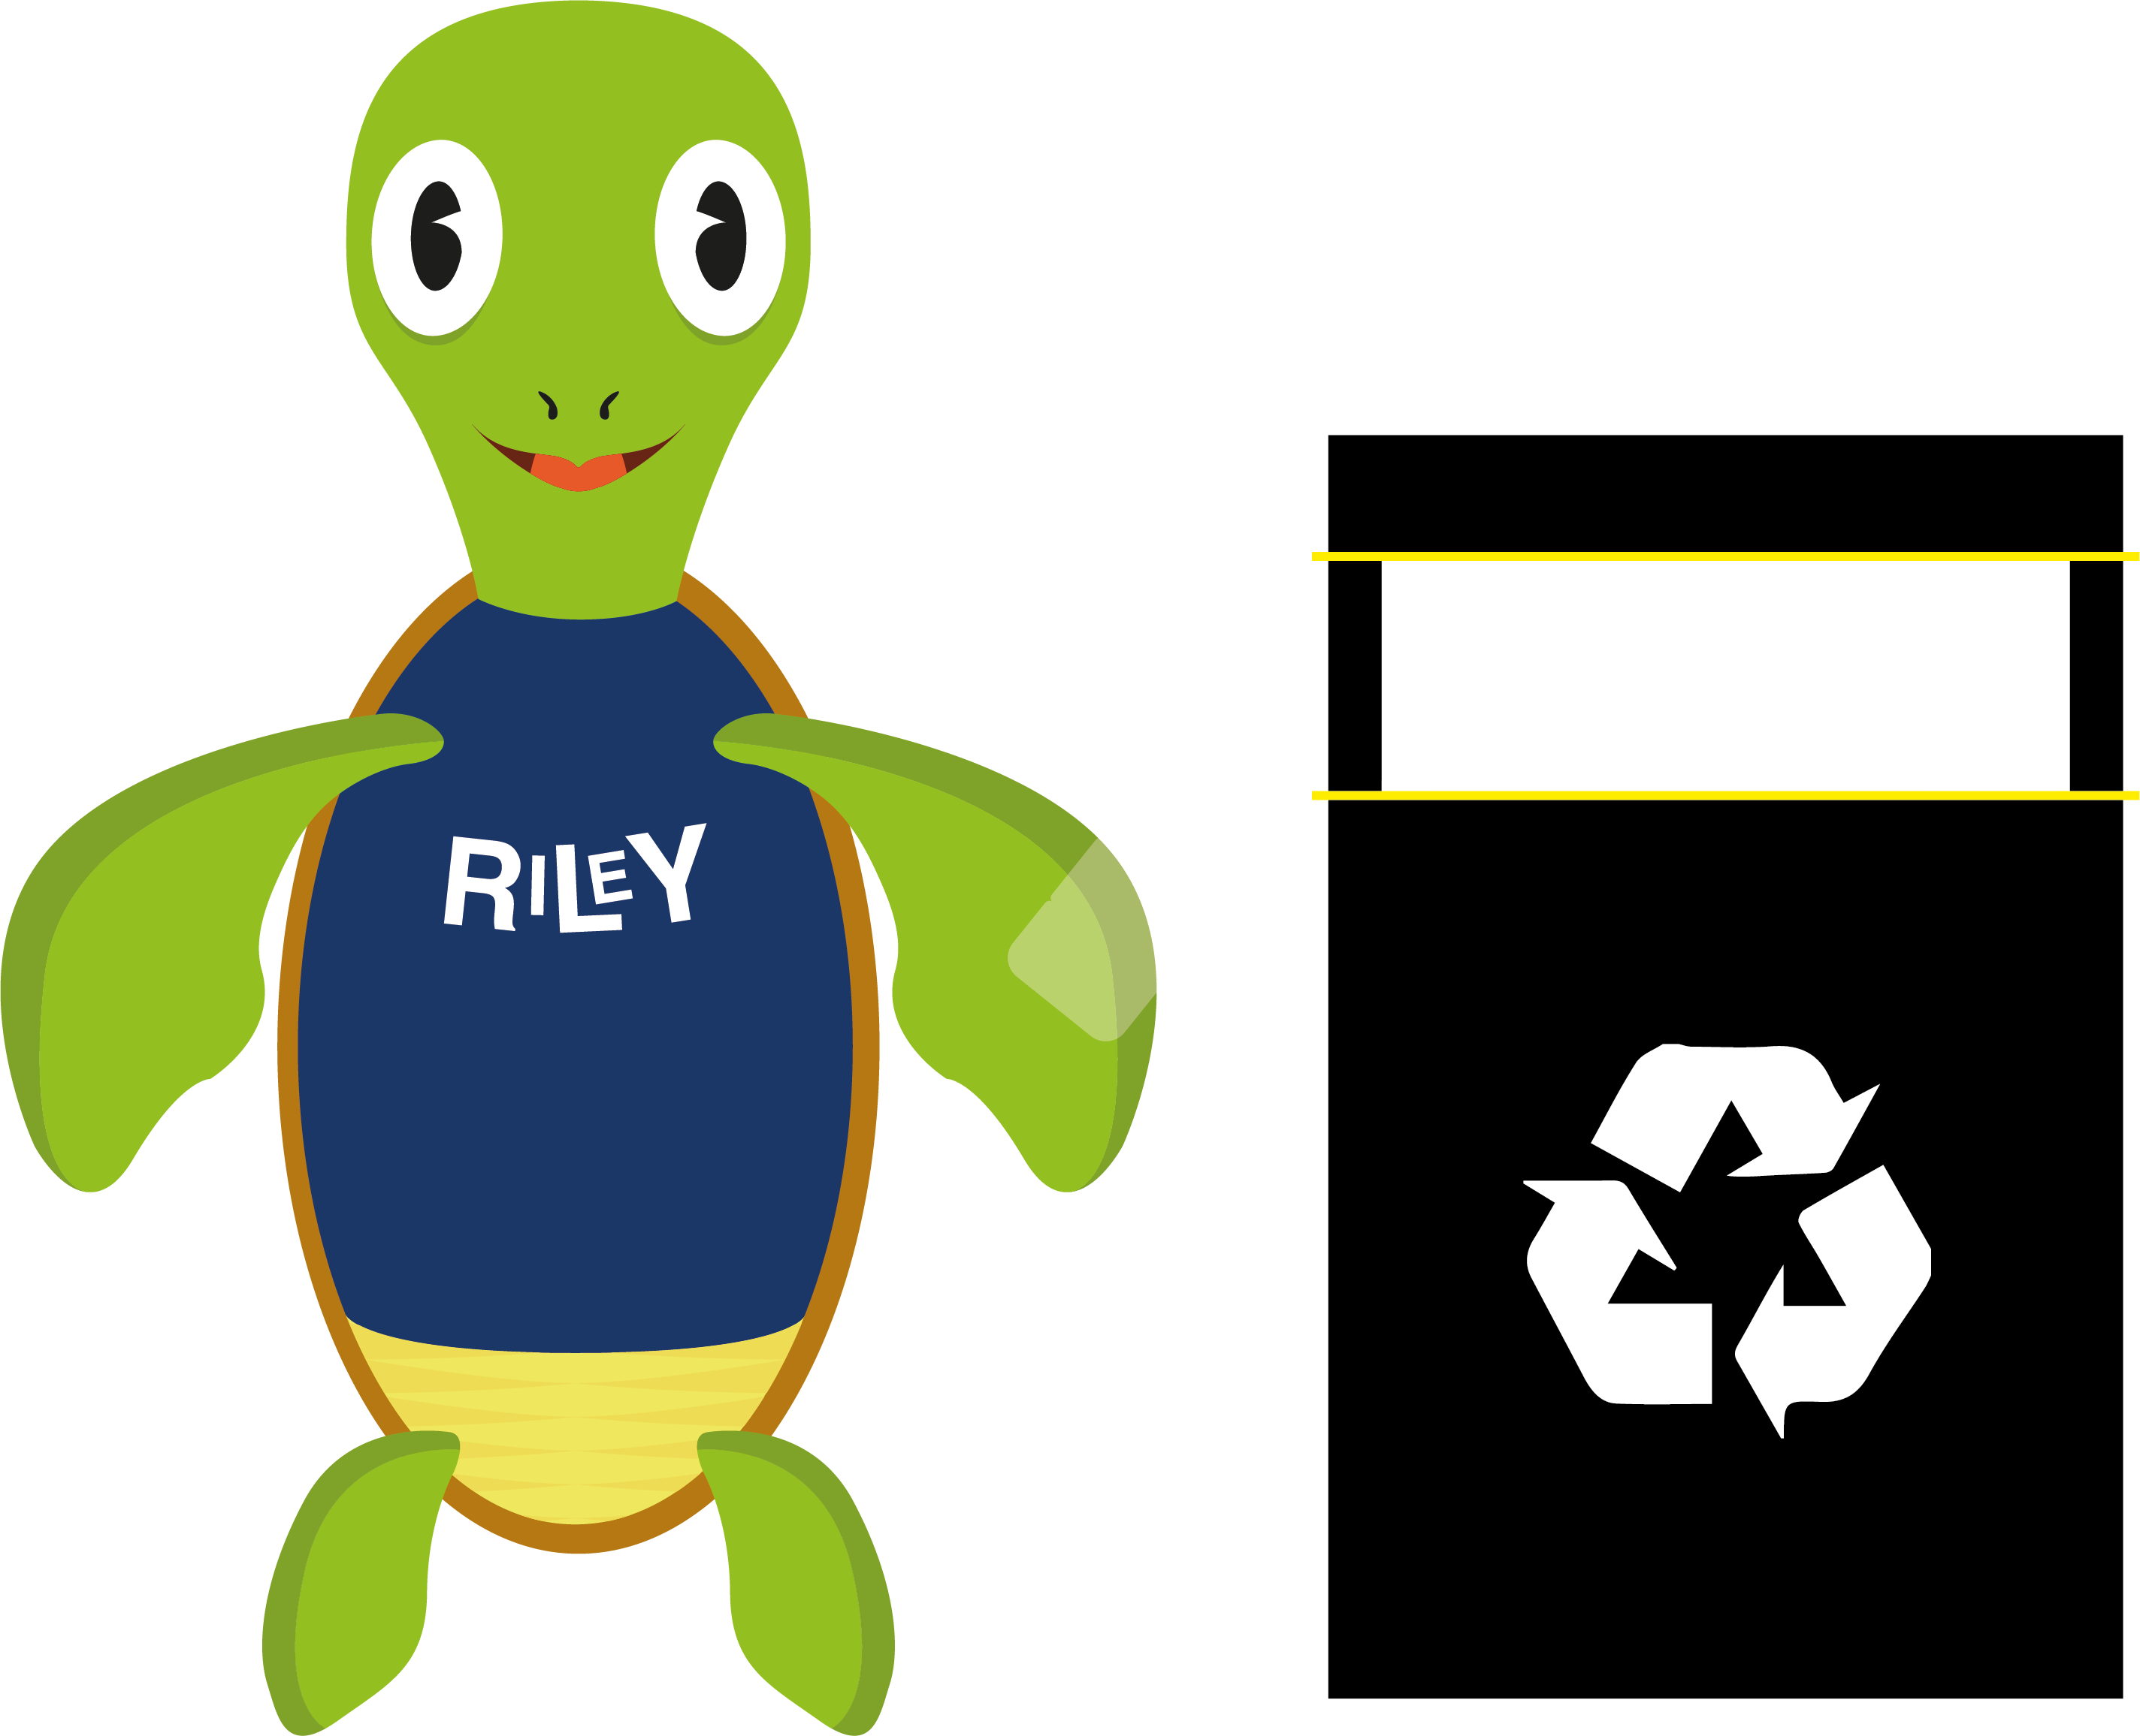
Recycle
Is to use again, or turn into something new
For example, we collect plastic waste and turn it into new products such as bin bags and garden furniture

Slide 7
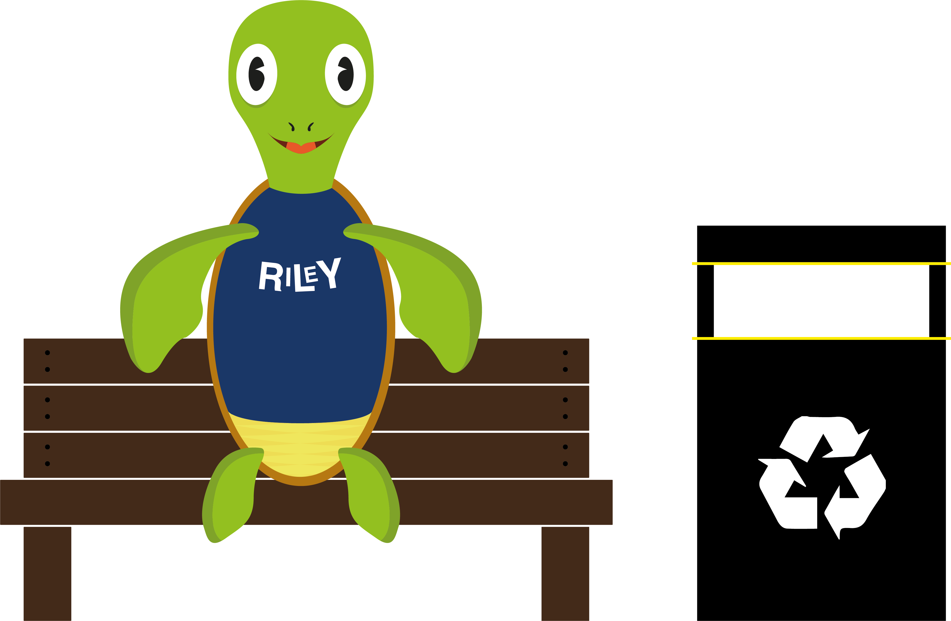
Plastic isn’t the problem
… the way we dispose of it is.
The plastics industry collects as much plastic waste as possible to recycle and make into new products

Slide 8
Why do we need plastic?
Plastic keeps our food fresh so its last longer and there is less waste
Without plastic we would have no phones, cars, computers and a million other everyday items
Plastic is an amazing invention

Slide 9
Every tonne of plastic
we recycle…
NOS
Saves 1.8 tonnes of crude oil
Reduces nitrous oxide emissions by 50%
Uses 90% less water
SO2
CO2
Cuts sulphur dioxide emissions by 33%
Reduces energy usage by two thirds
Prevents the release of 1.5 tonnes of CO2 compared to using prime polythene

Slide 10


How can you Recycle with Riley and help reduce plastic waste?

Slide 11
Recognise & Recycle
When you have plastic you have finished with and need to throw away, RECOGNISE that you can RECYCLE and help us work towards a world where nothing goes to waste
Ask your teacher where you can recycle plastic in your school.

Slide 12


What plastic can we recycle with Riley?
Soft flexible plastic that can
be scrunched up and folded easily
Such as:
vegetable/fruit bags, shopping bags, multi-pack drink packaging, mailing film and bread bags

Slide 13
What happens when you Recycle with Riley?

Slide 14

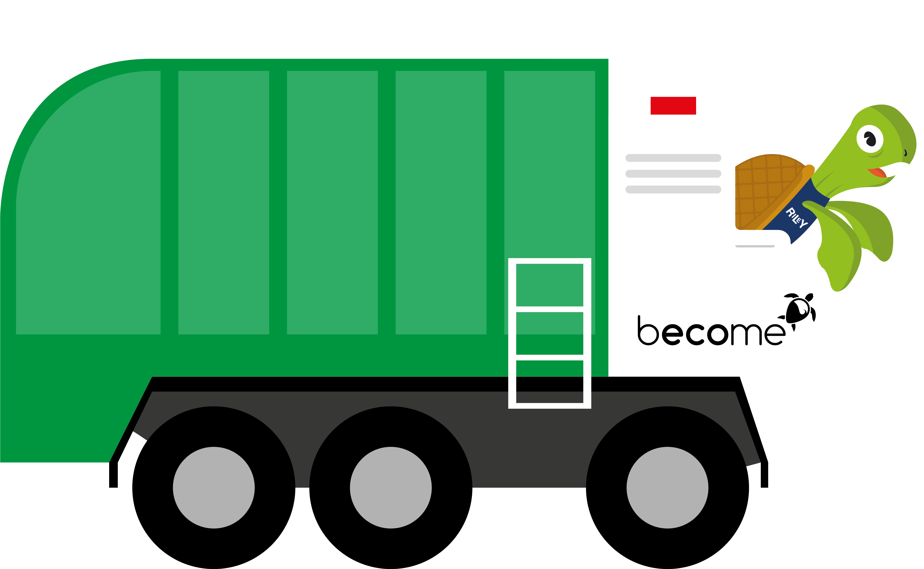
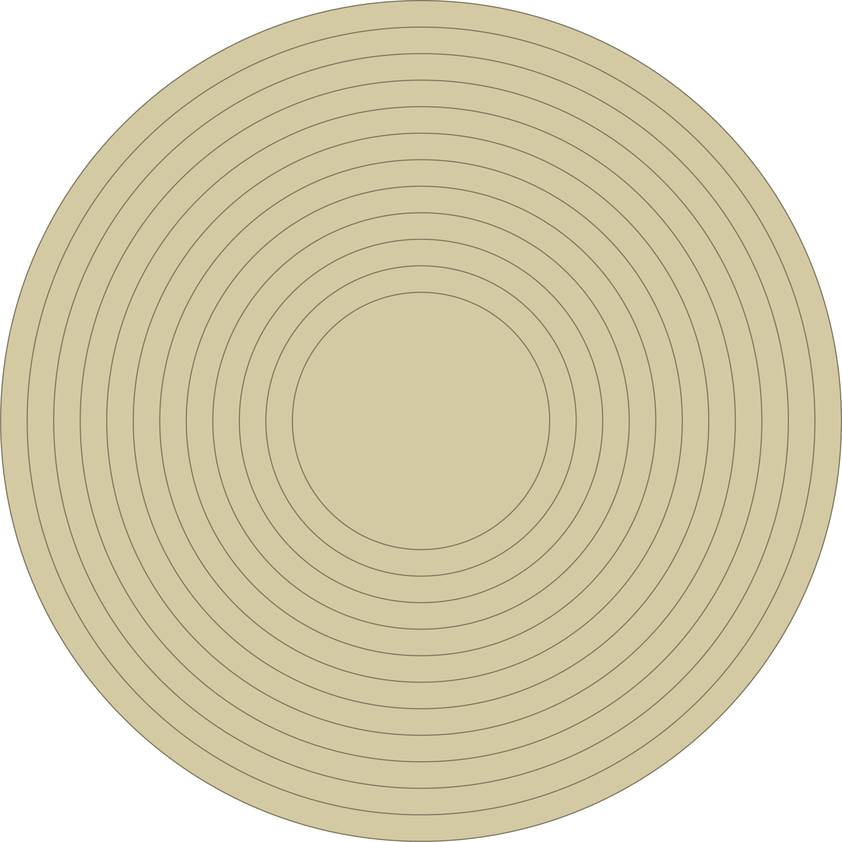
We will collect used plastic film from your school
We already collect from farmers and big companies such as Tesco and Amazon

Slide 15
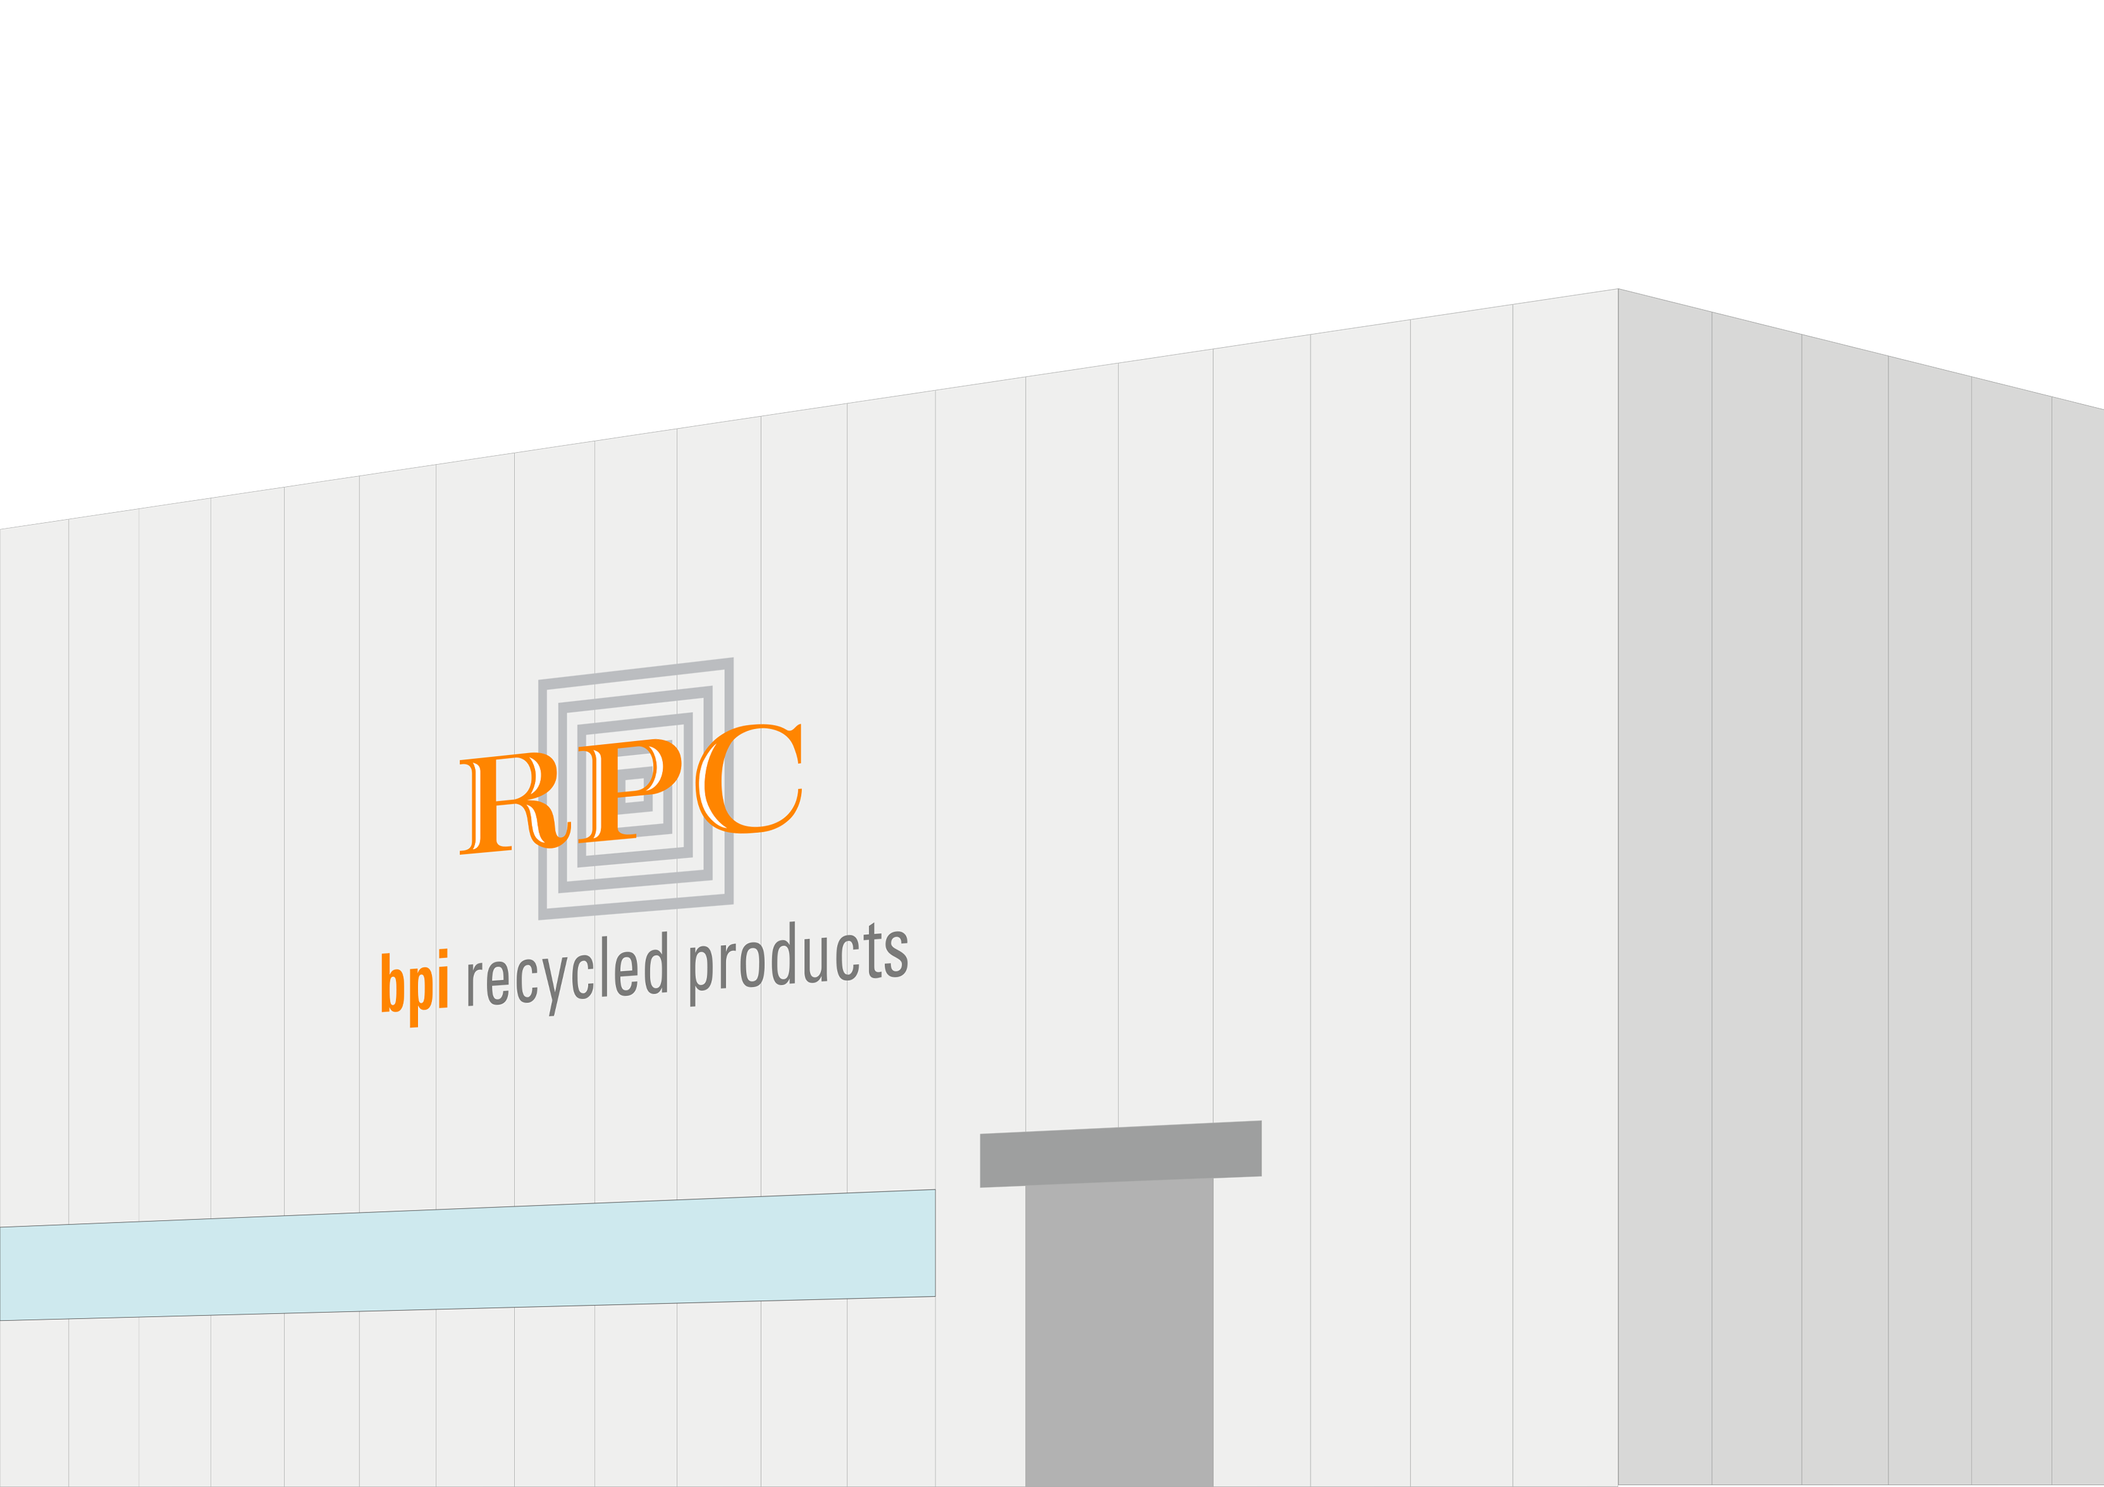
We then take the plastic to our factories around the UK

Slide 16
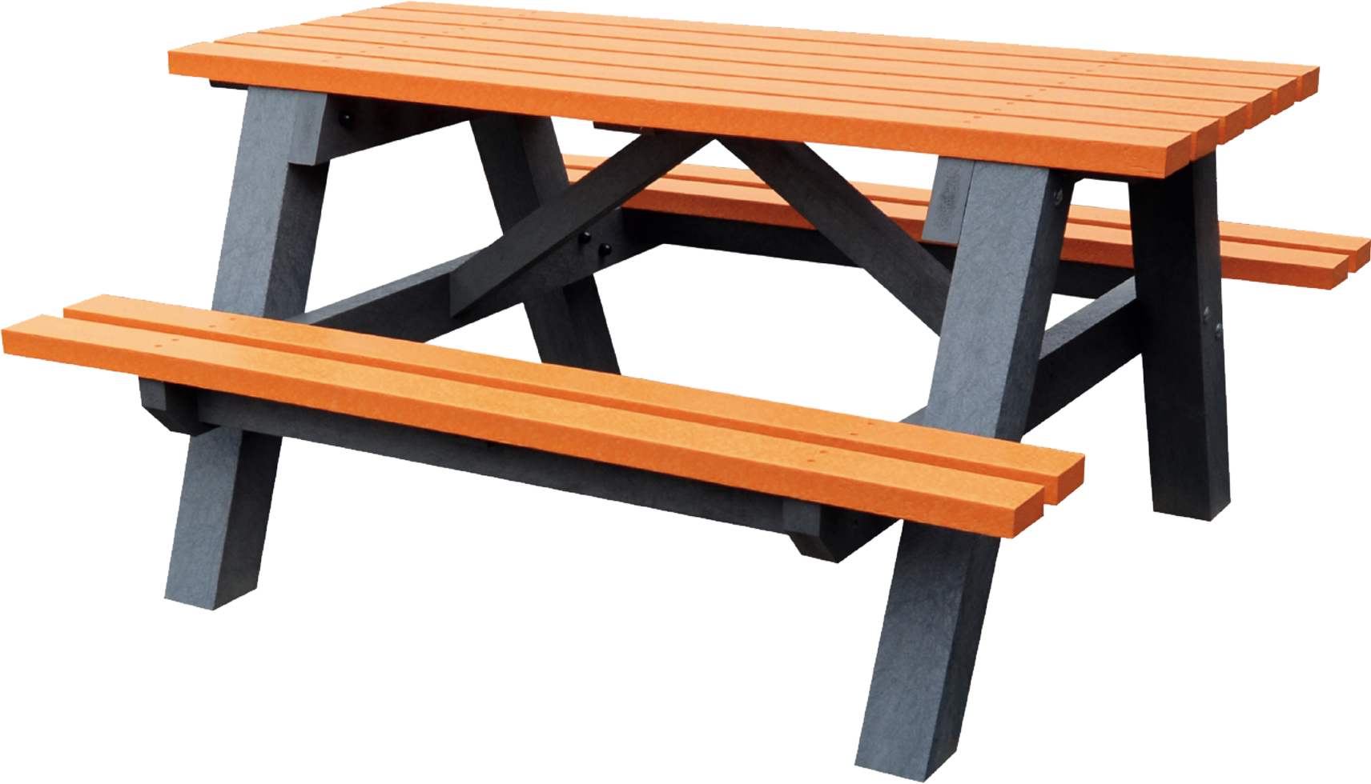
At the factory the plastic film is sorted, washed and made into plastic pellets ready to be made into new products, such as bin bags and garden furniture

Slide 17
Things to remember
Reduce, Reuse and Recycle.
Recycling with Riley at your school will ensure everyone understands the importance
of recycling and help keep plastic out of landfills, rivers and oceans
… and protect turtles like Riley too!

Slide 18

Any questions?

